Slide 1
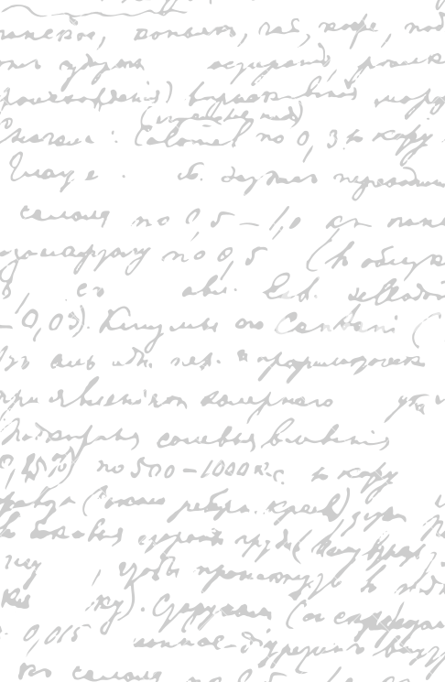



Andrew Wu 2133861w
The Waiter App
Hi!
Project Supervisor Meeting 3
14 October 2020

Slide 2
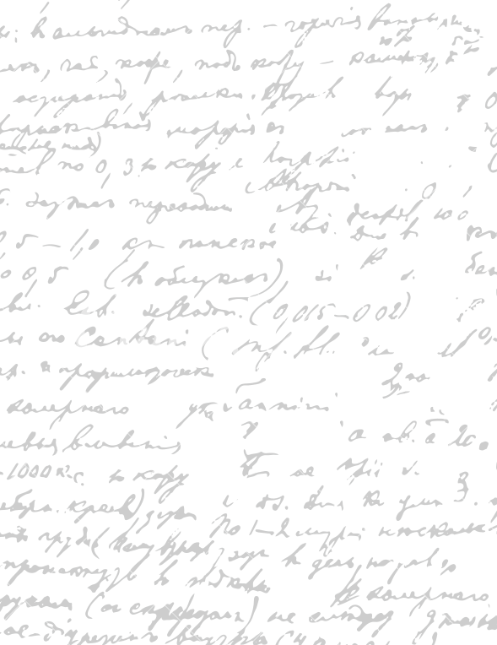



Start Recording

Slide 3
Main Topics
GitLab Setup
2. Requirement Statements
3. Test Driven Development with User Stories
4. Project Paper Prototype

Slide 4

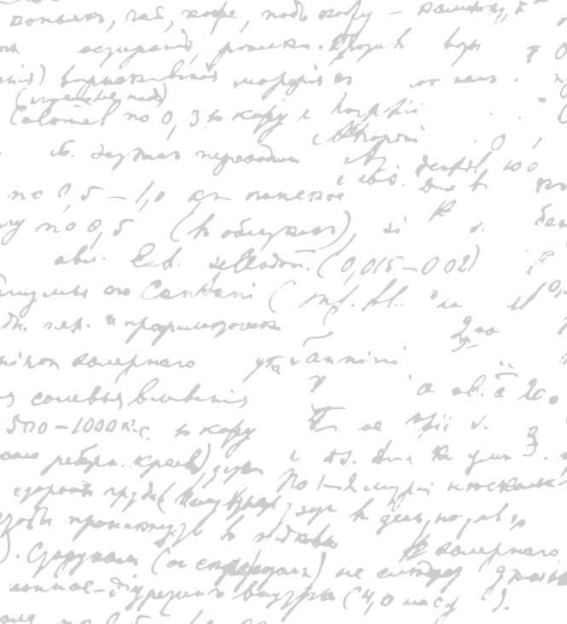

- Time Log
Dissertation Uploads
Weekly Status Report
Supervisor Meetings
University Material Summary
Example: go to your GitLab repository
GitLab Setup

Slide 5
Value Proposition Canvas
Define all the possible tasks each stakeholder (customers, chefs, waiters, owners) want to accomplish.
Define the gains (solutions) acquired and pains (issues) resolved by the software.
We will identify the software features (product & services) that act as their gain creators and the pain reliever.
Requirement Statement

Slide 6
Example: Go to Dissertation

Slide 7
Rewrite the Value Proposition Canvas
Identify the features that we want to implement to the minimum viable product
Develop minimal tests for your product
Draft product paper prototype for your minimum viable product
Evaluation
Next Week

Slide 8
Questions

Slide 9
End

